Slide 1
Time Series Forecasting
Lecture 5
Chapter 2: Regression Analysis and Time Series Analysis
Institute of Engineering
Asst. Prof. Anita Prajapati, Ph.D.
14 June 2023

Slide 2
Spreadsheet Modeling & Decision Analysis:
Chapter 11 : Time Series Forecasting
A Practical Introduction to Management Science, 3e
by Cliff Ragsdale

Slide 3
Introduction to Time Series Analysis
A time-series is a set of observations on a quantitative variable collected over time.
Examples
  Historical data on sales, inventory, customer counts, interest rates, costs, etc
Businesses are often very interested in forecasting time series variables.
Often, independent variables are not available to build a regression model of a time series variable.
In time series analysis, we analyze the past behavior of a variable in order to predict its future behavior.
11-<number>

Slide 4
Some Time Series Terms
Stationary Data - a time series variable exhibiting no significant upward or downward trend over time.
Nonstationary Data - a time series variable exhibiting a significant upward or downward trend over time.
Seasonal Data - a time series variable exhibiting a repeating patterns at regular intervals over time.
11-<number>

Slide 5
Approaching Time Series Analysis
There are many, many different time series techniques.
It is usually impossible to know which technique will be best for a particular data set.
It is customary to try out several different techniques and select the one that seems to work best.
To be an effective time series modeler, you need to keep several time series techniques in your “tool box.”
11-<number>

Slide 6
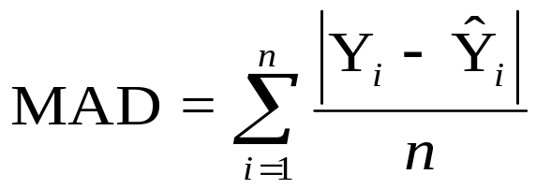
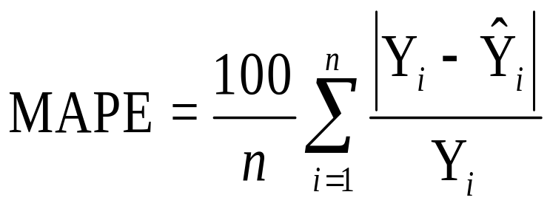
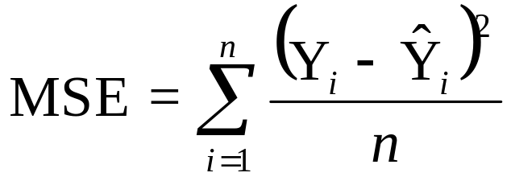
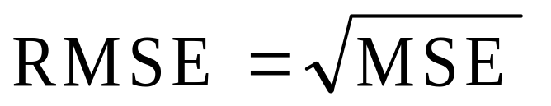
Measuring Accuracy
We need a way to compare different time series techniques for a given data set.
Four common techniques are the:
  mean absolute deviation,
  mean absolute percent error,
  the mean square error,
  root mean square error.
We will focus on MSE.
11-<number>

Slide 7
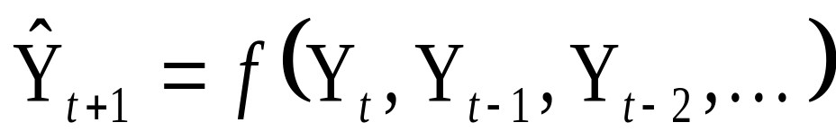
Extrapolation Models
Extrapolation models try to account for the past behavior of a time series variable in an effort to predict the future behavior of the variable.
We’ll first talk about several extrapolation techniques that are appropriate for stationary data.
11-<number>

Slide 8
An Example
Electra-City is a retail store that sells audio and video equipment for the home and car.
Each month the manager of the store must order merchandise from a distant warehouse.
Currently, the manager is trying to estimate how many VCRs the store is likely to sell in the next month.
He has collected 24 months of data.
See file Fig11-1.xls
11-<number>

Slide 9
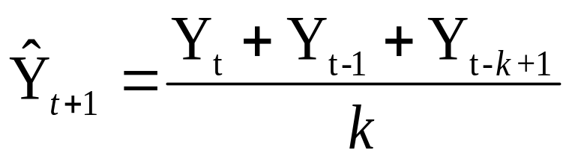
Moving Averages
No general method exists for determining k.
We must try out several k values to see what works best.
11-<number>

Slide 10
Implementing the Model
See file Fig11-2.xls
11-<number>

Slide 11
A Comment on Comparing MSE Values
Care should be taken when comparing MSE values of two different forecasting techniques.
The lowest MSE may result from a technique that fits older values very well but fits recent values poorly.
It is sometimes wise to compute the MSE using only the most recent values.
Spreadsheet Modeling and Decision Analysis, 3e, by Cliff Ragsdale. © 2001 South-Western/Thomson Learning.
11-<number>

Slide 12
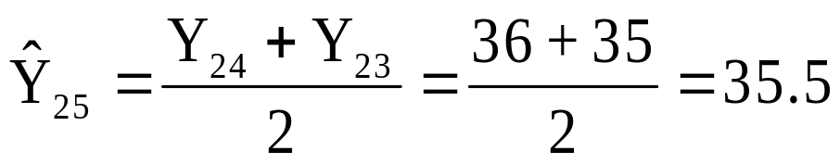
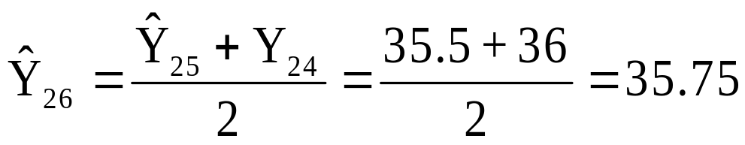
Forecasting With The Moving Average Model
Forecasts for time periods 25 and 26 at time period 24:
11-<number>

Slide 13
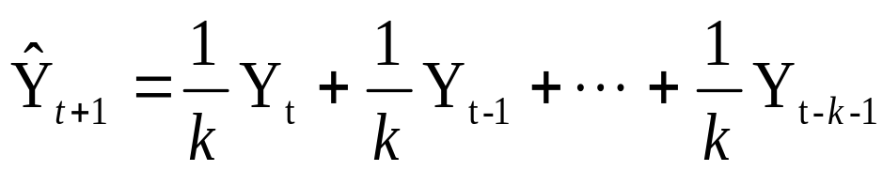
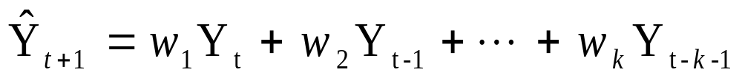
Weighted Moving Average
The moving average technique assigns equal weight to all previous observations
The weighted moving average technique allows for different weights to be assigned to previous observations.
We must determine values for k and the w_{i}
Spreadsheet Modeling and Decision Analysis, 3e, by Cliff Ragsdale. © 2001 South-Western/Thomson Learning.
11-<number>

Slide 14
Implementing the Model
See file Fig11-4.xls
Spreadsheet Modeling and Decision Analysis, 3e, by Cliff Ragsdale. © 2001 South-Western/Thomson Learning.
11-<number>

Slide 15
Forecasting With The Weighted Moving Average Model
Forecasts for time periods 25 and 26 at time period 24:
11-<number>

Slide 16
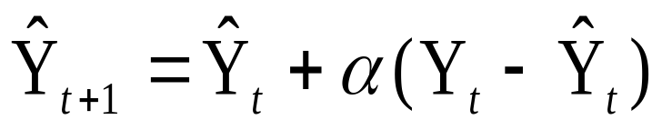

Exponential Smoothing
Another averaging technique for stationary data that allows weights to assign to past data
It can be shown that the above equation is equivalent to:
11-<number>

Slide 17
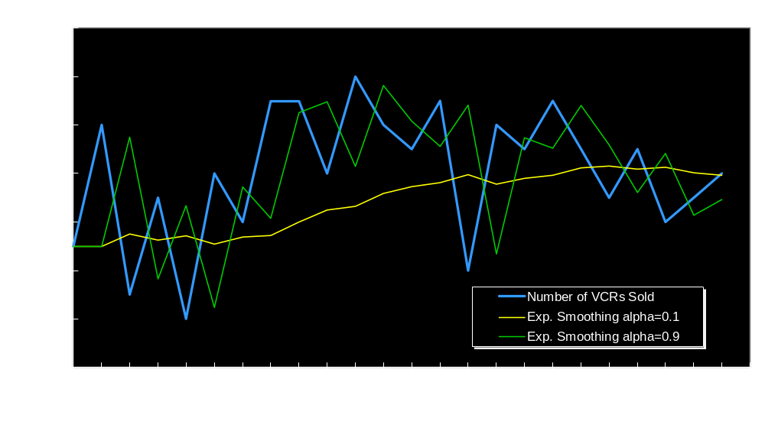
Examples of Two Exponential Smoothing Functions
Spreadsheet Modeling and Decision Analysis, 3e, by Cliff Ragsdale. © 2001 South-Western/Thomson Learning.
11-<number>

Slide 18
Implementing the Model
See file Fig11-8.xls
Spreadsheet Modeling and Decision Analysis, 3e, by Cliff Ragsdale. © 2001 South-Western/Thomson Learning.
11-<number>

Slide 19
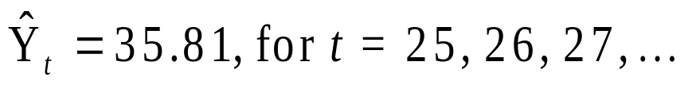
Forecasting With The Exponential Smoothing Model
Forecasts for time periods 25 and 26 at time period 24:
Note that,
11-<number>

Slide 20
Time Series Forecasting (Cont…)
Lecture 6
Chapter 2: Regression Analysis and Time Series Analysis
Institute of Engineering
Asst. Prof. Anita Prajapati, Ph.D.
16 June 2023

Slide 21
Seasonality
Seasonality is a regular, repeating pattern in time series data.
May be additive or multiplicative in nature...
11-<number>

Slide 22
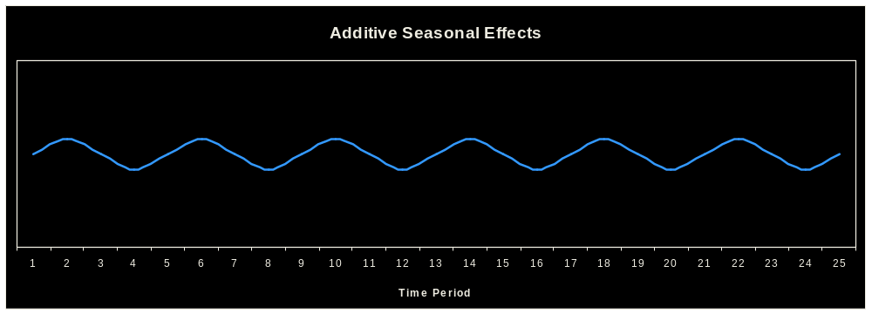
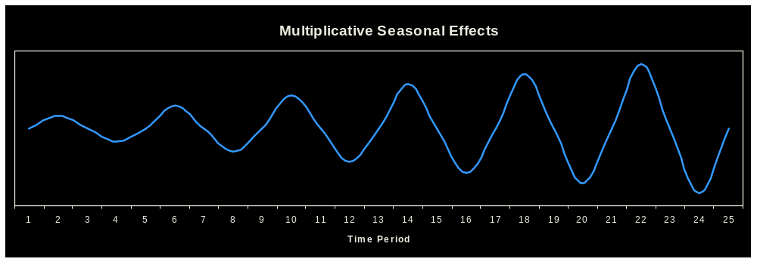
Stationary Seasonal Effects
11-<number>

Slide 23
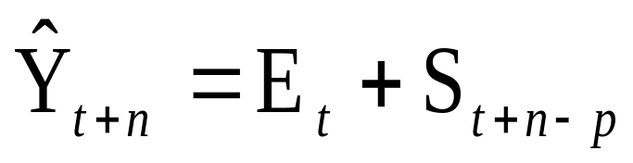
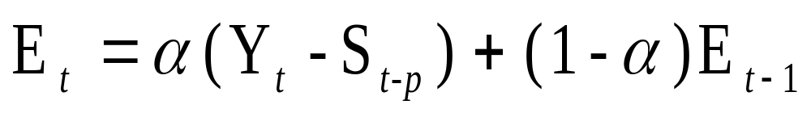
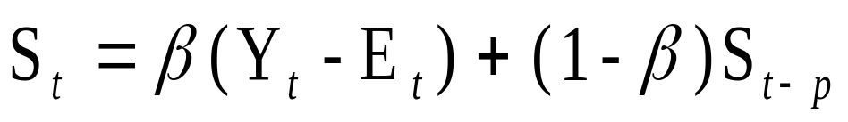
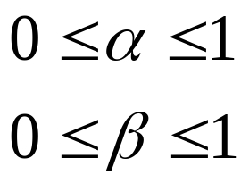
Stationary Data With Additive Seasonal Effects
where
p represents the number of seasonal periods
E_{t} is the expected level at time period t.
S_{t} is the seasonal factor for time period t.
11-<number>

Slide 24
Implementing the Model
See file Fig11-13.xls
11-<number>

Slide 25
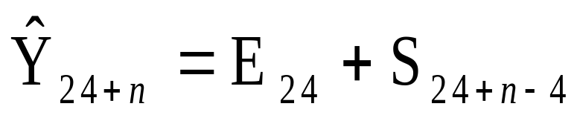
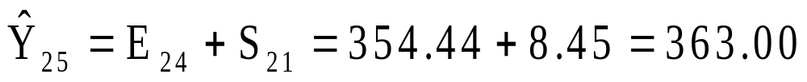
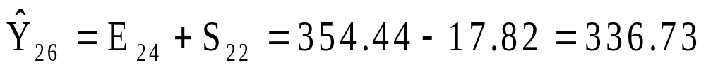
Forecasting With The Additive Seasonal Effects Model
Forecasts for time periods 25 - 28 at time period 24:
11-<number>

Slide 26
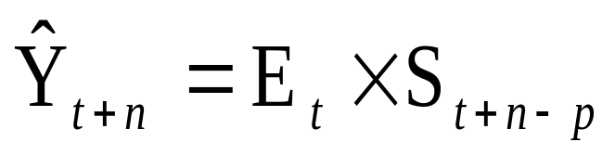
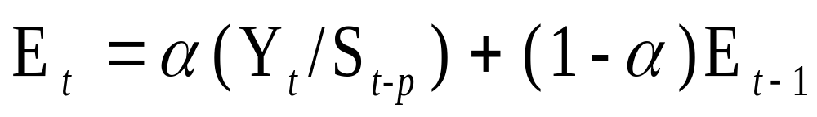
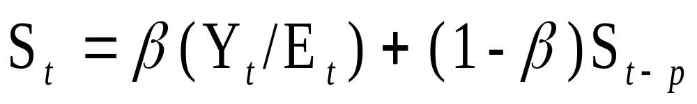
Stationary Data With Multiplicative Seasonal Effects
where
p represents the number of seasonal periods
E_{t} is the expected level at time period t.
S_{t} is the seasonal factor for time period t.
Spreadsheet Modeling and Decision Analysis, 3e, by Cliff Ragsdale. © 2001 South-Western/Thomson Learning.
11-<number>

Slide 27
Implementing the Model
See file Fig11-16.xls
11-<number>

Slide 28
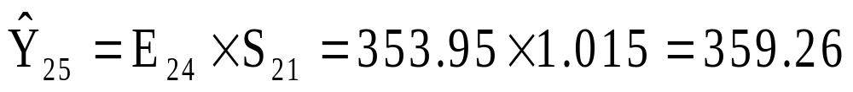
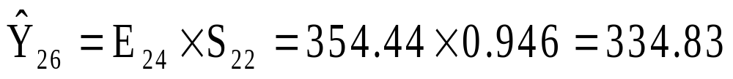
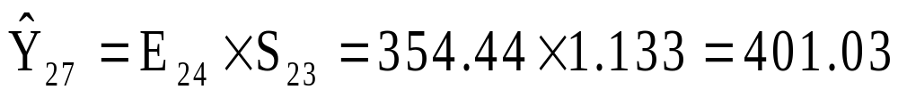
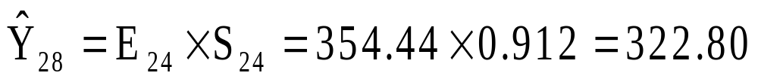
Forecasting With The Multiplicative, Seasonal Effects Model
Forecasts for time periods 25 - 28 at time period 24:
11-<number>

Slide 29
Trend Models
Trend is the long-term sweep or general direction of movement in a time series.
We’ll now consider some nonstationary time series techniques that are appropriate for data exhibiting upward or downward trends.
11-<number>

Slide 30
An Example
WaterCraft Inc. is a manufacturer of personal water crafts (also known as jet skis).
The company has enjoyed a fairly steady growth in sales of its products.
The officers of the company are preparing sales and manufacturing plans for the coming year.
Forecasts are needed of the level of sales that the company expects to achieve each quarter.
For quarterly sales data,
  see file Fig11-19.xls
11-<number>

Slide 31
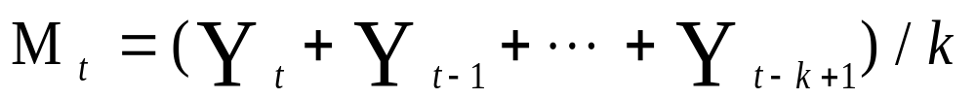
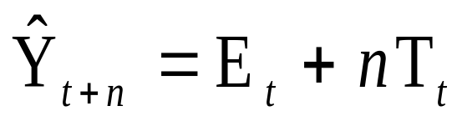
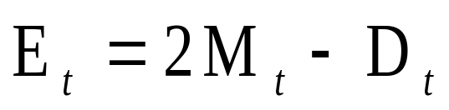
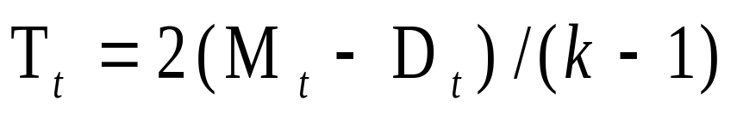
Double Moving Average
Involves the average of average
Moving average
Double moving average
Double moving average forecasting function
where
E_{t} is the expected base level at time period t.
T_{t} is the expected trend at time period t.
11-<number>

Slide 32
Implementing the Model
See file Fig11-20.xls
11-<number>

Slide 33
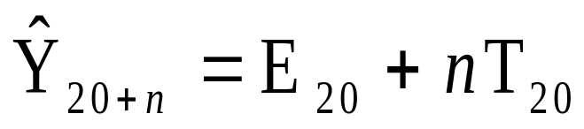
Forecasting With The Double Moving Average Model
Forecasts for time periods 21 through 24 at time period 20:
11-<number>

Slide 34

Double Exponential Smoothing
(Holt’s Method)
where
E_{t} = αY_{t} + (1-α)(E_{t-1}+ T_{t-1})
T_{t} = β(E_{t} −E_{t-1}) + (1-β) T_{t-1}
E_{t} is the expected base level at time period t.
T_{t} is the expected trend at time period t.
11-<number>

Slide 35
Implementing the Model
See file Fig11-22.xls
11-<number>

Slide 36
Forecasting With Holt’s Model
Forecasts for time periods 21 through 24 at time period 20:
11-<number>

Slide 37
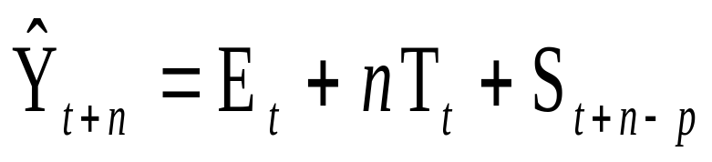
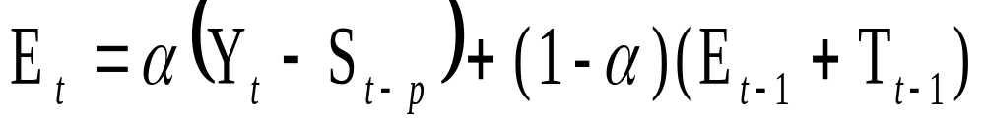
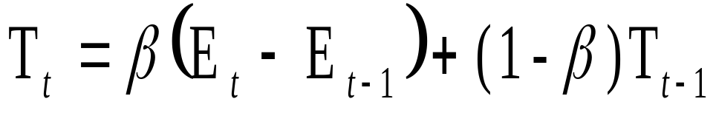
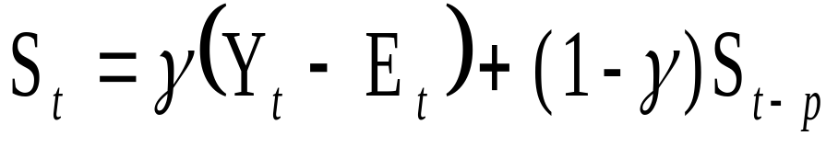
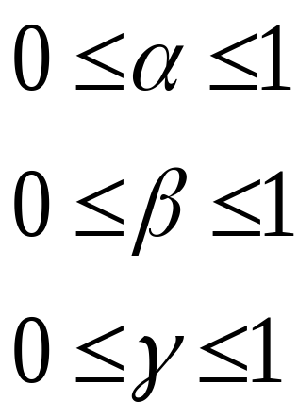
Holt-Winter’s Method For Additive Seasonal Effects
where
11-<number>

Slide 38
Implementing the Model
See file Fig11-25.xls
11-<number>

Slide 39
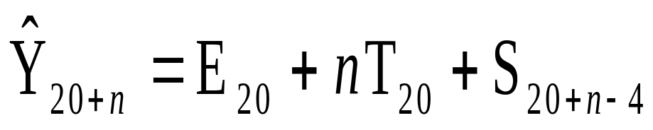
Forecasting With Holt-Winter’s
Additive Seasonal Effects Method
Forecasts for time periods 21 through 24 at time period 20:
11-<number>

Slide 40
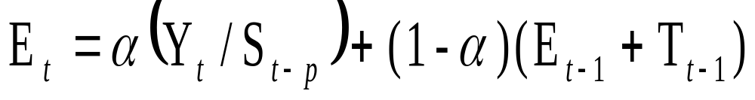
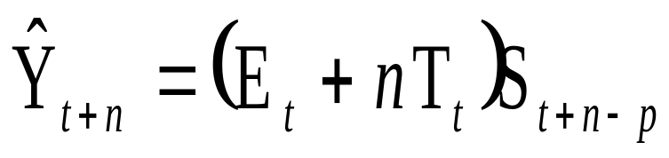
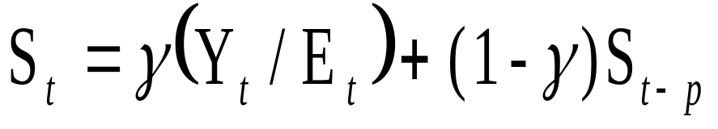
Holt-Winter’s Method For Multiplicative Seasonal Effects
where
11-<number>

Slide 41
Implementing the Model
See file Fig11-28.xls
11-<number>

Slide 42
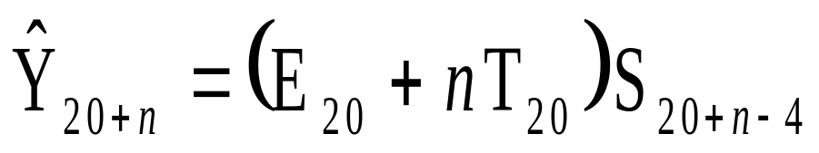
Forecasting With Holt-Winter’s Multiplicative Seasonal Effects
Method
Forecasts for time periods 21 through 24 at time period 20:
11-<number>

Slide 43
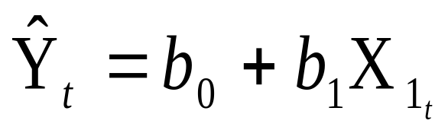
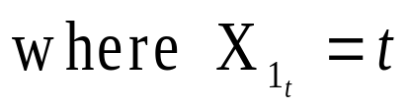

The Linear Trend Model
For example:
11-<number>

Slide 44
Implementing the Model
See file Fig11-31.xls
11-<number>

Slide 45
Forecasting With The Linear Trend Model
Forecasts for time periods 21 through 24 at time period 20:
Spreadsheet Modeling and Decision Analysis, 3e, by Cliff Ragsdale. © 2001 South-Western/Thomson Learning.
11-<number>

Slide 46
The TREND() Function
TREND(Y-range, X-range, X-value for prediction)
where:
Y-range is the spreadsheet range containing the dependent Y variable,
X-range is the spreadsheet range containing the independent X variable(s),
X-value for prediction is a cell (or cells) containing the values for the independent X variable(s) for which we want an estimated value of Y.
Note: The TREND( ) function is dynamically updated whenever any inputs to the function change. However, it does not provide the statistical information provided by the regression tool. It is best two use these two different approaches to doing regression in conjunction with one another.
11-<number>

Slide 47
Summary of the Calculation and Use of Seasonal Indices
1. Create a trend model and calculate the estimated value for each observation in the sample.
2. For each observation, calculate the ratio of the actual value to the predicted trend value:
(For additive effects, compute the difference:
3. For each season, compute the average of the ratios calculated in step 2. These are the seasonal indices.
4. Multiply any forecast produced by the trend model by the appropriate seasonal index calculated in step 3. (For additive seasonal effects, add the appropriate factor to the forecast.)
11-<number>

Slide 48
Refining the Seasonal Indices
Note that Solver can be used to simultaneously determine the optimal values of the seasonal indices and the parameters of the trend model being used.
There is no guarantee that this will produce a better forecast, but it should produce a model that fits the data better in terms of the MSE.
See file Fig11-39.xls
Spreadsheet Modeling and Decision Analysis, 3e, by Cliff Ragsdale. © 2001 South-Western/Thomson Learning.
11-<number>

Slide 49
Crystal Ball (CB) Predictor
CB Predictor is an add-in that simplifies the process of performing time series analysis in Excel.
A trial version of CB Predictor is available on the CD-ROM accompanying this book.
For more information on CB Predictor see:
  http://www.decisioneering.com
Spreadsheet Modeling and Decision Analysis, 3e, by Cliff Ragsdale. © 2001 South-Western/Thomson Learning.
11-<number>

Slide 50
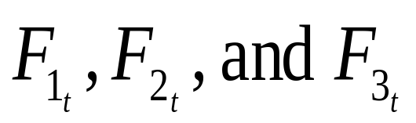
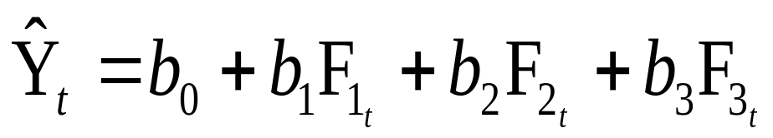
Combining Forecasts
It is also possible to combine forecasts to create a composite forecast.
Suppose we used three different forecasting methods on a given data set.
Denote the predicted value of time period t using each method as follows:
We could create a composite forecast as follows:
11-<number>

Slide 51
Summary
Several methods for forecasting future values of a time series variables
Discussed time series methods for stationary data, non-stationary data and seasonal patterns
Fit the model to the past behavior of a time series and use the models to project future values
Helps to be aware of different forecasting techniques and the types of problems for which they are intended
Often useful to try several techniques and then compare them based on measures of forecast accuracy
CD predictor makes it easy to apply several time series techniques to a data set and compare their accuracy
Combining the forecast form different procedures
11-<number>

Slide 52
Assignments
Chapter 11 from Ragsdale book
Question no.: 5,7,10,15,17,20,21, 22,31,32,47,48,57,58
11-<number>

Slide 53
End of Chapter 2
Spreadsheet Modeling and Decision Analysis, 3e, by Cliff Ragsdale. © 2001 South-Western/Thomson Learning.
11-<number>

